Slide 1
COMP 3500
Introduction to Operating Systems
Operating System Design
Dr. Xiao Qin
Auburn University
http://www.eng.auburn.edu/~xqin
xqin@auburn.edu

Slide 2
Purpose of an OS
Coordinate Use
of the Abstractions
Processes
The Abstractions
Create the Abstractions

Slide 3
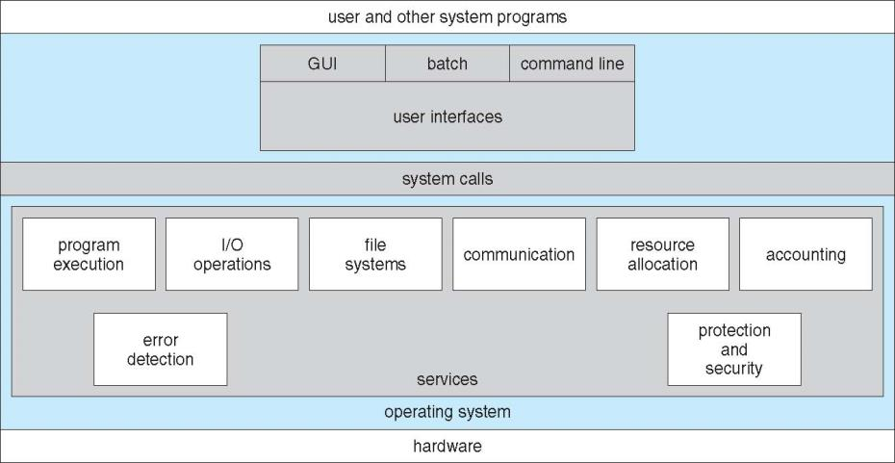
Operating System Services
Q1: Please write down two system services?
Notes:
OS provides an environment for execution of programs and services to programs and users
One set of operating-system services provides functions that are helpful to the user:
User interface - Almost all operating systems have a user interface (UI).
Varies between Command-Line (CLI), Graphics User Interface (GUI), Batch
Program execution - The system must be able to load a program into memory and to run that program, end execution, either normally or abnormally (indicating error)
I/O operations - A running program may require I/O, which may involve a file or an I/O device
One set of operating-system services provides functions that are helpful to the user (Cont.):
File-system manipulation - The file system is of particular interest. Programs need to read and write files and directories, create and delete them, search them, list file Information, permission management.
Communications – Processes may exchange information, on the same computer or between computers over a network
Communications may be via shared memory or through message passing (packets moved by the OS)
Error detection – OS needs to be constantly aware of possible errors
May occur in the CPU and memory hardware, in I/O devices, in user program
For each type of error, OS should take the appropriate action to ensure correct and consistent computing
Debugging facilities can greatly enhance the user’s and programmer’s abilities to efficiently use the system
Another set of OS functions exists for ensuring the efficient operation of the system itself via resource sharing
Resource allocation - When multiple users or multiple jobs running concurrently, resources must be allocated to each of them
Many types of resources - CPU cycles, main memory, file storage, I/O devices.
Accounting - To keep track of which users use how much and what kinds of computer resources
Protection and security - The owners of information stored in a multiuser or networked computer system may want to control use of that information, concurrent processes should not interfere with each other
Protection involves ensuring that all access to system resources is controlled
Security of the system from outsiders requires user authentication, extends to defending external I/O devices from invalid access attempts

Slide 4
Basic Operating System Organization
File
Manager
Process, Thread &
Resource Manager
Memory
Manager
Device
Manager
Processor(s)
Main Memory
Devices
Notes:
Programming interface to the services provided by the OS
Typically written in a high-level language (C or C++)
Mostly accessed by programs via a high-level Application Programming Interface (API) rather than direct system call use
Three most common APIs are Win32 API for Windows, POSIX API for POSIX-based systems (including virtually all versions of UNIX, Linux, and Mac OS X), and Java API for the Java virtual machine (JVM)

Slide 5
Kernel Mode vs. User Mode
Kernel Mode.
  Executing code has complete and unrestricted access to the underlying hardware.
  Is reserved for the lowest-level, trusted functions of OS.
  Crashes in this mode are catastrophic.
User Mode
  Executing code has no ability to directly access hardware
  Code must delegate to system APIs to access hardware
  Crashes in user mode are always recoverable
Notes:
Kernel ModeIn Kernel mode, the executing code has complete and unrestricted access to the underlying hardware. It can execute any CPU instruction and reference any memory address. Kernel mode is generally reserved for the lowest-level, most trusted functions of the operating system. Crashes in kernel mode are catastrophic; they will halt the entire PC.
User ModeIn User mode, the executing code has no ability to directly access hardware or reference memory. Code running in user mode must delegate to system APIs to access hardware or memory. Due to the protection afforded by this sort of isolation, crashes in user mode are always recoverable. Most of the code running on your computer will execute in user mode.

Slide 6
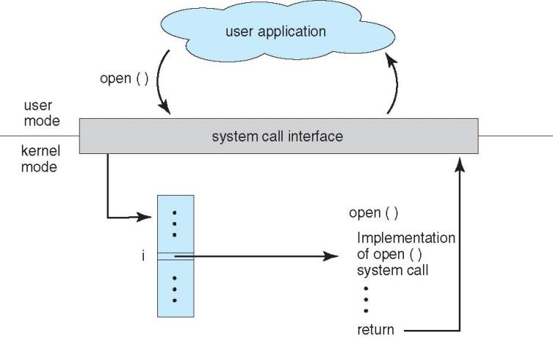
API – System Call – OS Relationship

Slide 7
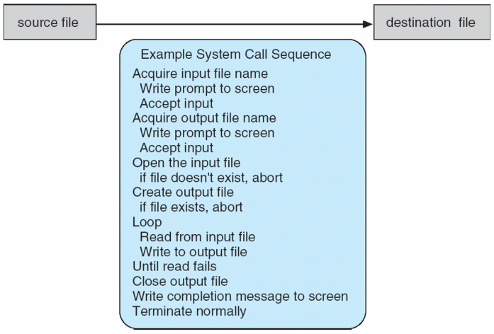
System Calls
System call sequence to copy the contents of one file to another file
Notes:
Programming interface to the services provided by the OS
Typically written in a high-level language (C or C++)
Mostly accessed by programs via a high-level Application Programming Interface (API) rather than direct system call use
Three most common APIs are Win32 API for Windows, POSIX API for POSIX-based systems (including virtually all versions of UNIX, Linux, and Mac OS X), and Java API for the Java virtual machine (JVM)

Slide 8
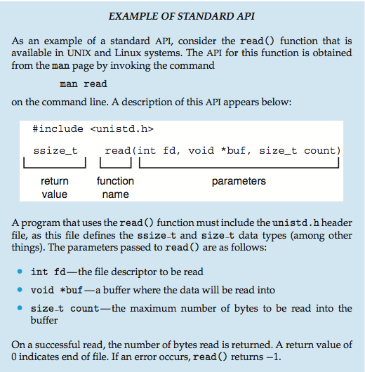
Notes:
System Call Implementation
Typically, a number associated with each system call
System-call interface maintains a table indexed according to these numbers
The system call interface invokes the intended system call in OS kernel and returns status of the system call and any return values
The caller need know nothing about how the system call is implemented
Just needs to obey API and understand what OS will do as a result call
Most details of OS interface hidden from programmer by API
Managed by run-time support library (set of functions built into libraries included with compiler)
System Call Parameter Passing
Often, more information is required than simply identity of desired system call
Exact type and amount of information vary according to OS and call
Three general methods used to pass parameters to the OS
Simplest: pass the parameters in registers
In some cases, may be more parameters than registers
Parameters stored in a block, or table, in memory, and address of block passed as a parameter in a register
This approach taken by Linux and Solaris
Parameters placed, or pushed, onto the stack by the program and popped off the stack by the operating system
Block and stack methods do not limit the number or length of parameters being passed

Slide 9
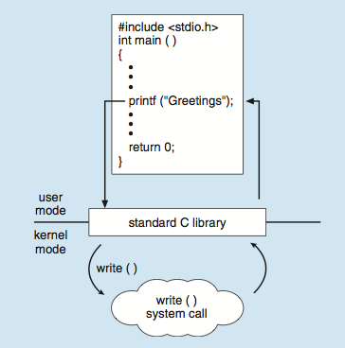
Standard C Library Example
Q2: Why printf() must call the write() system call?
Notes:
C program invoking printf() library call, which calls write() system call

Slide 10
User Goals vs. System Goals
Q3: Which of the following goals are end-user goals?
Which of the following goals are system goals?
Convenient to use
Easy to implement
Easy to learn
Reliable
Easy to maintain
Flexible
Error-free
Efficient and Fast
Safe
Easy to design
Notes:
Design and Implementation of OS not “solvable”, but some approaches have proven successful
Internal structure of different Operating Systems can vary widely
Start the design by defining goals and specifications
Affected by choice of hardware, type of system
Users: use and learn
System: design, implement, and maintain
User goals and System goals
User goals – operating system should be convenient to use, easy to learn, reliable, safe, and fast
System goals – operating system should be easy to design, implement, and maintain, as well as flexible, reliable, error-free, and efficient

Slide 11
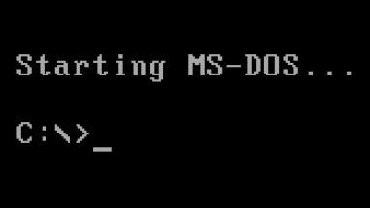
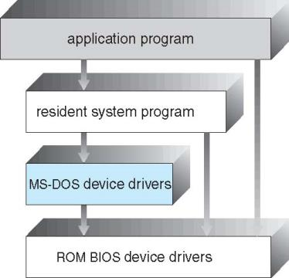
Simple Structure -- MS-DOS
Goal: the most functionality in the least space
Not divided into modules
Interfaces and levels of functionality are not well separated
Notes:
General-purpose OS is very large program
Various ways to structure ones
Simple structure – MS-DOS
More complex -- UNIX
Layered – an abstrcation
Microkernel –Mach
MS-DOS (/ˌɛmɛsˈdɒs/ em-es-doss; acronym for Microsoft Disk Operating System) is an operating system for x86-based personal computers mostly developed byMicrosoft. It was the most commonly used member of the DOS family of operating systems, and was the main operating system for IBM PC compatible personal computers during the 1980s to the mid-1990s, when it was gradually superseded by operating systems offering a graphical user interface (GUI), in various generations of the Microsoft Windows operating system.
MS-DOS resulted from a request in 1981 by IBM for an operating system to use in its IBM PC range of personal computers.^{[7][8]} Microsoft quickly bought the rights to 86-DOS from Seattle Computer Products,^{[9]} and began work on modifying it to meet IBM's specification. IBM licensed and released it in August 1981 as PC DOS1.0 for use in their PCs. Although MS-DOS and PC DOS were initially developed in parallel by Microsoft and IBM, in subsequent years the two products went their separate ways.
During its life, several competing products were released for the x86 platform,^{[10]} and MS-DOS went through eight versions, until development ceased in 2000. Initially MS-DOS was targeted at Intel 8086 processors running on computer hardware using floppy disks to store and access not only the operating system, but application software and user data as well. Progressive version releases delivered support for other mass storage media in ever greater sizes and formats, along with added feature support for newer processors and rapidly evolving computer architectures. Ultimately it was the key product in Microsoft's growth from aprogramming languages company to a diverse software development firm, providing the company with essential revenue and marketing resources. It was also the underlying basic operating system on which early versions of Windows ran as a GUI. It is a flexible operating system, and consumes negligible installation space.

Slide 12
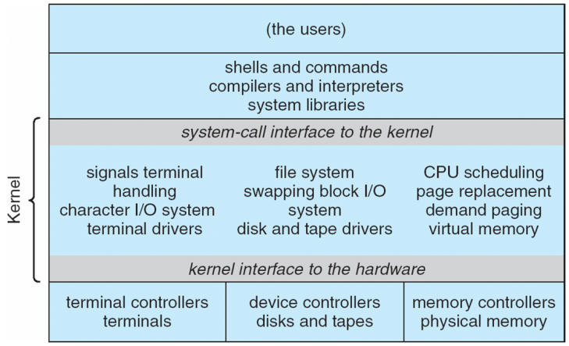
Monolithic Kernel
UNIX System Structure
Notes:
A monolithic kernel is an operating system architecture where the entire operating system is working in kernel space and is alone in supervisor mode. The monolithic model differs from other operating system architectures (such as the microkernel architecture)^{[1][2]} in that it alone defines a high-level virtual interface over computer hardware. A set of primitives or system calls implement all operating system services such as process management, concurrency, and memory management. Device drivers can be added to the kernel as modules.
Non Simple Structure -- UNIX
UNIX – limited by hardware functionality, the original UNIX operating system had limited structuring. The UNIX OS consists of two separable parts
Systems programs
The kernel
Consists of everything below the system-call interface and above the physical hardware
Provides the file system, CPU scheduling, memory management, and other operating-system functions; a large number of functions for one level

Slide 13
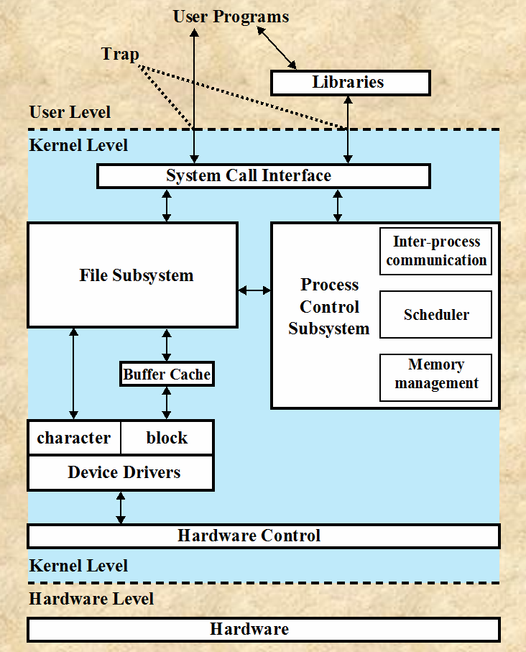
Q4: What are the pros and cons of this structure?
Notes:
Benefits:
High performance. Performance overhead of user space to kernel space communication
Detriments:
difficult to port the operating system to new architectures

Slide 14
Microkernel System Structure
Q5: What are the pros and cons of this structure?
Notes:
In computer science, a microkernel (also known as μ-kernel) is the near-minimum amount of software that can provide the mechanisms needed to implement an operating system (OS). These mechanisms include low-level address space management,thread management, and inter-process communication (IPC).
Moves as much from the kernel into user space
Mach example of microkernel
Mac OS X kernel (Darwin) partly based on Mach
Communication takes place between user modules using message passing
Benefits:
Easier to extend a microkernel
Easier to port the operating system to new architectures
More reliable (less code is running in kernel mode)
More secure
Detriments:
Performance overhead of user space to kernel space communication

Slide 15
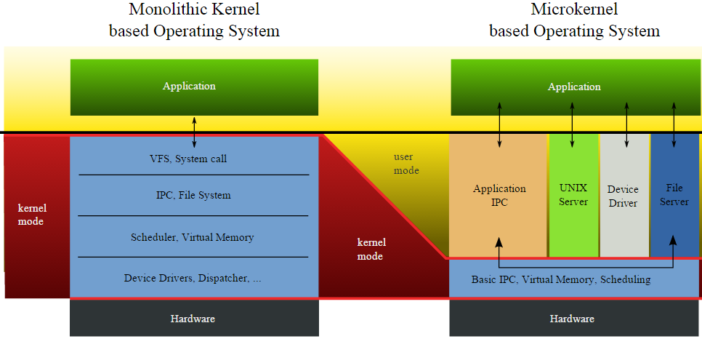
Monolithic Kernel vs. Microkernel
Q6: Which structure should we use to build an OS for embedded systems (e.g., real-time robotic systems)?

Slide 16
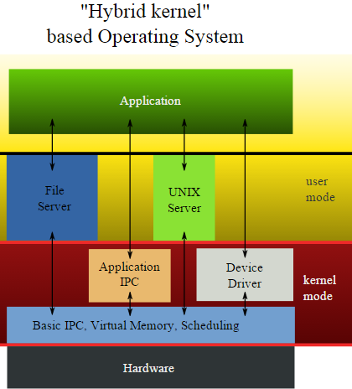
Hybrid Systems
Notes:
Most modern operating systems are actually not one pure model
Hybrid combines multiple approaches to address performance, security, usability needs
Linux and Solaris kernels in kernel address space, so monolithic, plus modular for dynamic loading of functionality
Windows mostly monolithic, plus microkernel for different subsystem personalities
Apple Mac OS X hybrid, layered, Aqua UI plus Cocoa programming environment
Below is kernel consisting of Mach microkernel and BSD Unix parts, plus I/O kit and dynamically loadable modules (called kernel extensions)

Slide 17
Mac OS X Structure

Slide 18
iOS
Structured on Mac OS X, added functionality
Does not run OS X applications natively
  Also runs on different CPU architecture (ARM vs. Intel)
Cocoa Touch Objective-C API for developing apps
Media services layer for graphics, audio, video
Core services provides cloud computing, databases
Core operating system, based on Mac OS X kernel
Notes:
Apple mobile OS for iPhone, iPad

Slide 19
Android Architecture
Notes:
Developed by Open Handset Alliance (mostly Google)
Open Source
Similar stack to IOS
Based on Linux kernel but modified
Provides process, memory, device-driver management
Adds power management
Runtime environment includes core set of libraries and Dalvik virtual machine
Apps developed in Java plus Android API
Java class files compiled to Java bytecode then translated to executable than runs in Dalvik VM
Libraries include frameworks for web browser (webkit), database (SQLite), multimedia, smaller libc

Slide 20
Summary
OS Services
Basic Operating System Organization
Kernel Mode vs. User Mode
Monolithic Kernel
Microkernel

